Slide 1
Understand Qur’an & Salah The Easy Way

Lesson -7

Slide 2
In this lesson…
Qur’an: How to learn? and supplication
Grammar : هٰذَا، هٰؤُلآءِ، ذٰلِكَ، أولٰئِكَ
Educational tip: How much do we remember?
In this lesson you will learn 8 new words which occur in Quran almost 1,596 times
Notes:
2
Allah has chosen you out of the thousands that are out there. Thank Allah for this tremendous blessing by learning with full attention and interaction.
You have already come walking towards Allah. Now He will come running towards you (as in Hadith). InshaAllah, you will continue in this journey till the end.

Slide 3
78,000
By the end of this lesson, we will learn
49 words which occur in quran almost 24,490 times
There are 4,500 words in Quran which are repeated almost 78,000 times
24,490

Slide 4
Easy understanding
1
In last lesson
وَلَقَدْ | يَسَّرْنَا الْقُرْآنَ | لِلذِّكْرِ
And indeed | We have made the Qur'an easy | to understand and remember
Notes:
Purpose of revelation is: Tadabbur & Tazakkur.
This should be done in Arabic Aayaat because Qur’an is in Arabic only.
But Allah says that He has made is EXTREMELY EASY!
And He is asking: Is there anyone? WE should say: O ALLAH! Here we are! We want to understand and learn. (Check-Plan-Propagate).

Slide 5
Not Only Easy but Excellent Work
2
In last lesson
خَيْرُكُمْ | مَّنْ | تَعَلَّمَ الْقُرْآنَ | وَعَلَّمَه،
The best of you | (is the one) who | learns the Qur'an | and teaches it.
Notes:
Student is mentioned first and then the teacher. So, another push..
Don’t stop at learning. Plan for teaching too. RIGHT NOW make Niyyah and you will get ajar.
List 2 names whom you will teach. Or start at your home. It is a saying of Prophet Muhammad pbuh but actually it is from Allah. Allah is watching you; so respond now by making niyyah.

Slide 6
Most Important: Intention
3
In last lesson
إِنَّمَا الْأَعْمَالُ | بِالنِّيَّاتِ (بخارى)
Actions (are based) only | on intentions.
Notes:
Our intention is to please Allah only.

Slide 7
سُورَةُ طه، آية 114
رَبِّ | زِدْنِي | عِلْمًا (طه : 114)
O my Lord! | increase me | in knowledge.

Slide 8
رَبِّ | زِدْنِي | عِلْمًا (طه : 114)
O my Lord! | increase me | in knowledge.
ر ب ب
Takes care of us & helps us grow
… Every cell of the billions of cells…

Slide 9
رَبِّ | زِدْنِي | عِلْمًا (طه : 114)
O my Lord! | increase me | in knowledge.
ز ي د
نِي | زِدْ
me | increase

Slide 10
رَبِّ | زِدْنِي | عِلْمًا (طه : 114)
O my Lord! | increase me | in knowledge.
ع ل م

Slide 11
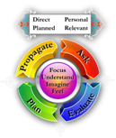
Message from:
رَبِّ | زِدْنِي | عِلْمًا (طه : 114)
O my Lord! | Increase me | in knowledge.
Some … say: Just
No other du’aa has the request of increase
Knowledge helps in action

Slide 12
Message from:
رَبِّ | زِدْنِي | عِلْمًا (طه : 114)
O my Lord! | increase me | in knowledge.
This prayer was taught to the Prophet. Surah Taha:
وَلَا تَعْجَلْ بِالْقُرْآنِ مِن قَبْلِ أَن يُقْضَى إِلَيْكَ وَحْيُهُ وَقُل رَّبِّ زِدْنِي عِلْمًا
So, make sure to pray with this as often as you can. Try it after Ayatul-Kursi!

Slide 13
Message from:
رَبِّ | زِدْنِي | عِلْمًا (طه : 114)
O my Lord! | increase me | in knowledge.
A heart patient
A person hungry for days
Let us pray like:
a sick person who wants to get rid of sickness of ignorance
a starving person who really feels hunger of divine knowledge.

Slide 14
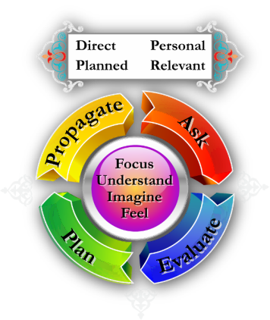
Practice
رَبِّ | زِدْنِي | عِلْمًا (طه : 114)
in
knowledge.
increase
me
O my Lord!
Esp. with Imagination & feelings; Prayer & Evaluation

Slide 15
سُورَةُ العلق، آية 4
الَّذِي | عَلَّمَ | بِالْقَلَمِ (العلق: 4)
(The one) Who | taught | by the pen.

Slide 16
الَّذِي | عَلَّمَ | بِالْقَلَمِ (العلق: 4)
(The one) Who | Taught | by the pen.
304 times

Slide 17
الَّذِي | عَلَّمَ | بِالْقَلَمِ (العلق: 4)
(The one) Who | taught | by the pen.
صراط الذين أنعمت عليهم
+
 |  | الَّذِي
الَّذِينَ
those who
the one who

Slide 18
الَّذِي | عَلَّمَ | بِالْقَلَمِ (العلق: 4)
(The one) Who | taught | by the pen.
ع ل م
تَعَلَّمَ
خَيْرُكُمْ مَنْ
تَعَلَّمَ الْقُرْآنَ
وَعَلَّمَه،
عَلَّمَ

Slide 19
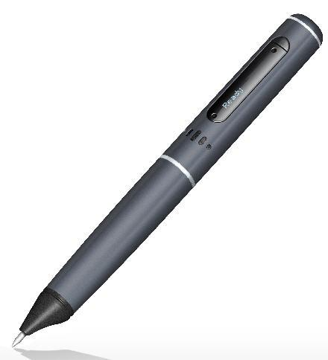
الَّذِي | عَلَّمَ | بِالْقَلَمِ (العلق: 4)
(The one) Who | taught | by the pen.
بِ + الْقَلَمِ
the pen
by

Slide 20
Message from:
الَّذِي | عَلَّمَ | بِالْقَلَمِ (العلق: 4)
(The one) Who | taught | by the pen.
So pick up the pen immediately
You wrote millions of words with your hand. Now, use the pen for learning Arabic
And make it a habit
You will then need a notebook
Keep a record of what you are learning

Slide 21
Message from:
الَّذِي | عَلَّمَ | بِالْقَلَمِ (العلق: 4)
(The one) Who | taught | by the pen.
Where will you write? On a notebook
Keep a record of what you are learning…
Develop a small library of books and notebooks

Slide 22
Practice
الَّذِي | عَلَّمَ | بِالْقَلَمِ (العلق: 4)
by the
pen.
(The one)
who
taught
Esp. with Imagination & feelings; Prayer & Evaluation

Slide 23
سُورَةُ المُلك، آية 2
أَيُّكُمْ | أَحْسَنُ | عَمَلاً (الملك: 2)
Which of you | is better | in deeds?

Slide 24
أَيُّكُمْ | أَحْسَنُ | عَمَلاً (الملك: 2)
Which of you | is better | in deeds?
أَيُّ كُمْ
Which of you

Slide 25
أَيُّكُمْ | أَحْسَنُ | عَمَلاً (الملك: 2)
Which of you | is better | in deeds?
ح س ن
كَبِير أكْبَر
Bigger
Smaller
Better
Big
Small
Good
صَغِير أَصْغَر
حَسَن أحْسَن

Slide 26
أَيُّكُمْ | أَحْسَنُ | عَمَلاً (الملك: 2)
Which of you | is better | in deeds?
ع م ل
+
 |  | عَمَل
أَعْمَال
إِنَّمَا الْأَعْمَالُ بِاالنِّيَّات

Slide 27
أَيُّكُمْ | أَحْسَنُ | عَمَلاً (الملك: 2)
Which of you | is better | in deeds?
ع م ل
إِنَّمَا الْأَعْمَالُ بِاالنِّيَّات
عَمَل أَعْمَال

Slide 28
Message from:
أَيُّكُمْ | أَحْسَنُ | عَمَلاً (الملك: 2)
Which of you | is better | in deeds?
Competition is not between Muslims and others…
Who performs best; best in Salah; best outside, best neighbor, best son; best person; & HERE… best student

Slide 29
Practice
أَيُّكُمْ | أَحْسَنُ | عَمَلاً (الملك: 2)
Which of you
in deeds?
is better
Esp. with Imagination & feelings; Prayer & Evaluation

Slide 30
Compete … for Allah
Shaitaan is ready with his arsenal. You have started learning Qur’an… He must be burning with rage! He will try his best to stop you from this.
Angels are ready (always!) with their pens.
A special competition has begun. Don’t spare any effort to learn seriously.
Notes:
PL: Need to correct the niyyah, again and again
PL: Need to do that du’aa again & again
PL: Need to keep using this hand and the pen to learn Qur’an again and again
PL: Keep this spirit of competition alive and renew it again and again (whenever it dies). Never quit and never slow down. And if for whatever reason, you stop, start it over again. There is no question of giving it up anyway.

Slide 31
Now Listen to all the verses!

Slide 32
Supplicate repeatedly
1
رَبِّ | زِدْنِي | عِلْمًا
O My Lord! | Increase me | in knowledge.
سُورَةُ طه، آية 114
Notes:
32

Slide 33
Use pen and all available resources
2
الَّذِي | عَلَّمَ | بِالْقَلَمِ
(The one) Who | Taught | by the pen.
سُورَةُ العلق، آية 4
Notes:
33

Slide 34
Compete for Allah
3
أَيُّكُمْ | أَحْسَنُ | عَمَلاً
Which of you | is better | in deeds?
سُورَةُ المُلك، آية 2
Notes:
34

Slide 35
TPS-W
Think
1 minute
Pair & Share
2 minutes
Write
4 minutes

Slide 36
Break!

