Slide 1
Let’s Understand the Qur’an Lesson -5a
بسم الله الرحمن الرحيم

Slide 2
In this lesson…
Qur’an: Purpose of revelation - Surah Saad (29)
Grammar : لِ، مِنْ، عَنْ، مَعَ
Educational tip: About remembering …
In this lesson you will learn 9 new words which occur in Quran almost 7806 times
Notes:
2
Allah has chosen you out of the thousands that are out there. Thank Allah for this tremendous blessing by learning with full attention and interaction.
You have already come walking towards Allah. Now He will come running towards you (as in Hadith). InshaAllah, you will continue in this journey till the end.

Slide 3
78,000
4,500
By the end of this lesson, we will learn
32 words which occur in quran almost 16892 times
There are 4,500 words in Quran which are repeated almost 78000 times
16,892

Slide 4
The purpose of Revelation
Pondering | 1. تَدَبُّر
receiving admonition | 2. تَذَكُّر
Notes:
With intention, Du’aa, and then support of Allah… NO PROBLEM INSHA-ALLAH.

Slide 5
سُورَةُ ص، آية 29
كِتَابٌ | أَنزَلْنَاهُ | إِلَيْكَ | مُبَارَكٌ
(It is) a book | We have revealed it | to you (O! Muhammad, pbuh) | full of blessings;

Slide 6
كِتَابٌ | أَنزَلْنَاهُ | إِلَيْكَ | مُبَارَكٌ
(It is) a book | We have revealed it | to you (O! Muhammad, pbuh) | full of blessings;
ك ت ب
book

Slide 7
كِتَابٌ | أَنزَلْنَاهُ | إِلَيْكَ | مُبَارَكٌ
(It is) a book | We have revealed it | to you (O! Muhammad, pbuh) | full of blessings;
ك ت ب
263*
+
 |  | كِتَاب
كُتُب

Slide 8
كِتَابٌ | أَنزَلْنَاهُ | إِلَيْكَ | مُبَارَكٌ
(It is) a book | We have sent down | to you (O! Muhammad, pbuh) | full of blessings;
ن ز ل
we sent down
أَنْزَلْنَا

Slide 9
كِتَابٌ | أَنزَلْنَاهُ | إِلَيْكَ | مُبَارَكٌ
(It is) a book | We have revealed it | to you (O! Muhammad, pbuh) | full of blessings;
ن ز ل
أَنْزَلْنَا + هُ
it we sent down

Slide 10
كِتَابٌ | أَنزَلْنَاهُ | إِلَيْكَ | مُبَارَكٌ
(It is) a book | We have revealed it | to you (O! Muhammad, pbuh) | full of blessings;
إِلَى + كَ
you to

Slide 11
كِتَابٌ | أَنزَلْنَاهُ | إِلَيْكَ | مُبَارَكٌ
(It is) a book | We have revealed it | to you (O! Muhammad, pbuh) | full of blessings;
ب ر ك
عِيد مُبَارَك
Let this Eid be a BLESSING (for you)

Slide 12
Practice with Imagination and Feelings
كِتَابٌ | أَنزَلْنَاهُ
We have
revealed it
(It is) a book
إِلَيْكَ | مُبَارَكٌ
full of
blessings;
to you (O! Muhammad, pbuh)

Slide 13
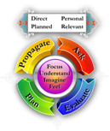
Message from:
كِتَابٌ | أَنزَلْنَاهُ | إِلَيْكَ | مُبَارَكٌ
(It is) a book | We have revealed it | to you (O! Muhammad, pbuh) | full of blessings;
First feel His infinite Mercy and Kindness…
How happy should we be to receive this BOOK! This happiness is shown by our attachment (reading, studying, spreading)
Note the words… We stop at barakah; but Allah did not stop here. It goes on…

Slide 14
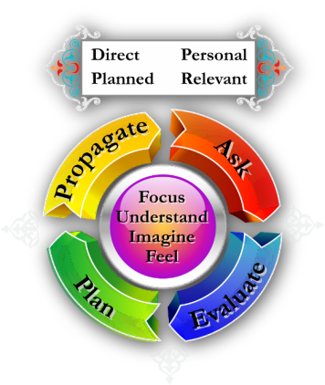
Practice
كِتَابٌ | أَنزَلْنَاهُ | إِلَيْكَ | مُبَارَكٌ
(It is) a book | We have revealed it | to you (O! Muhammad, pbuh) | full of blessings;
Esp. with Imagination & feelings; Prayer & Evaluation

Slide 15
سُورَةُ ص، آية 29
لِّيَدَّبَّرُوا | آيَاتِهِ
so that they ponder | its verses

Slide 16
لِّيَدَّبَّرُوا | آيَاتِهِ
so that they ponder | its verses
لِ
د ب ر
so that

Slide 17
لِّيَدَّبَّرُوا | آيَاتِهِ
so that they ponder | its verses
د ب ر
لِ يَدَّبَّرُوا
they ponder so that

Slide 18
لِّيَدَّبَّرُوا | آيَاتِهِ
so that they ponder | its verses
آيَة
Verse
Sign

Slide 19
لِّيَدَّبَّرُوا | آيَاتِهِ
so that they ponder | its verses
ء ي ي
+
آيَات
 |  | آيَة

Slide 20
لِّيَدَّبَّرُوا | آيَاتِهِ
so that they ponder | its verses
ء ي ي
آيَات هٖ
its verses

Slide 21
Message from:
لِّيَدَّبَّرُوا | آيَاتِهِ
so that they ponder | its verses
Ponder, to think over
Example: Can you read a math book like a story book.
Revealed for pondering!
Pondering possible only after understanding

Slide 22
Practice
لِّيَدَّبَّرُوا | آيَاتِهِ
so that they ponder | its verses
Esp. with Imagination & feelings; Prayer & Evaluation

Slide 23
سُورَةُ ص، آية 29
وَلِيَتَذَكَّرَ | أُوْلُوا | الْأَلْبَابِ (ص 29)
and so that (they) receive admonition | those of | understanding.

Slide 24
وَلِيَتَذَكَّرَ | أُوْلُوا | الْأَلْبَابِ (ص 29)
and so that (they) receive admonition | those of | understanding.
ذ ك ر
لِ
so
that

Slide 25
وَلِيَتَذَكَّرَ | أُوْلُوا | الْأَلْبَابِ (ص 29)
and so that (they) receive admonition | those of | understanding.
ذ ك ر
وَ لِ يَتَذَكَّرَ
they receive
admonition
so
that
and

Slide 26
So that لِ :
لِّيَدَّبَّرُوآ ا ٰ يَاتِه_{ا}
وَلِيَتَذَكَّرَ أُوْلُوا الْأَلْبَابِ
لِ

Slide 27
وَلِيَتَذَكَّرَ | أُوْلُوا | الْأَلْبَابِ (ص 29)
and so that (they) receive admonition | those of | understanding.
Those of | أُوْلُوا أُولِي

Slide 28
وَلِيَتَذَكَّرَ | أُوْلُوا | الْأَلْبَابِ (ص 29)
and so that (they) receive admonition | those of | understanding.
ل ب ب
+
 |  | لُبّ
أَلْبَاب
Heart, Mind, Intellect

Slide 29
Message from:
وَلِيَتَذَكَّرَ | أُوْلُوا | الْأَلْبَابِ (ص 29)
and so that (they) receive admonition | those of | understanding.
Receiving admonition: Bring into life
Example: You catch a hot iron

Slide 30
Practice
وَلِيَتَذَكَّرَ | أُوْلُوا | الْأَلْبَابِ (ص 29)
and so that (they) receive admonition | those of | understanding.
Esp. with Imagination & feelings; Prayer & Evaluation

Slide 31
To receive full barakah, we need to
Ponder | 1. تَدَبُّر
Receive Admonition | 2. تَذَكُّر
Notes:
With intention, Du’aa, and then support of Allah… NO PROBLEM INSHA-ALLAH.

Slide 32
How to bring Quran to our lives?

Slide 33
Before we ponder, Let us look at Our Relationship with the Qur’an
DPPR
Direct
Personal
Planned
Relevant
www.understandquran.com
Notes:
Direct: For you; it is not Imam reciting or reading the book written by someone
Planned: Before even you were born; it is not random
Personal: For you
Relevant: For today

Slide 34
1. Direct
While reading, we say that this book (Qur’an) is Allah’s Book,
When listening to Qur’an, we say that these are the words of Allah.
Which means Allah is directly addressing us.
In fact, he watches us and observes our reactions to His commands!
Notes:
34
This is about the best people, whom Allah loves. Whenever they are reminded, i.e., whenever they listen or read the Qur’an, they take it as a REMINDER. Therefore WHENEVER we listen to or read the Qur’an, we should take it as if Allah is talking to us Directly… TERE ZAMEER PAR JAB TAK NA HO… HE IS WATCHING. HE IS ALIVE.
We should take it for ourselves; personal.
We also know that everything is planned. Part of Qadr.
We should take it as relevant. O Allah! Why did u make me listen to this verse. DANE DANE PE LIKHA HAI …

Slide 35
2. Personal
Whatever you recite or listen, take the instructions as those ‘for me’.
Do not take the verses as: these are for Disbelievers, those for Idolaters, for Hypocrites of Medina …….
In fact, we should see what is in there for us.
Notes:
35
This is about the best people, whom Allah loves. Whenever they are reminded, i.e., whenever they listen or read the Qur’an, they take it as a REMINDER. Therefore WHENEVER we listen to or read the Qur’an, we should take it as if Allah is talking to us Directly… TERE ZAMEER PAR JAB TAK NA HO… HE IS WATCHING. HE IS ALIVE.
We should take it for ourselves; personal.
We also know that everything is planned. Part of Qadr.
We should take it as relevant. O Allah! Why did u make me listen to this verse. DANE DANE PE LIKHA HAI …

Slide 36
3. Planned
Every thing is part of Qadr, something predestined… even the grains that we eat…
Therefore, every Ayah that we hear or listen to, is part of the fate, which was written, before even we were born.
Notes:
36
This is about the best people, whom Allah loves. Whenever they are reminded, i.e., whenever they listen or read the Qur’an, they take it as a REMINDER. Therefore WHENEVER we listen to or read the Qur’an, we should take it as if Allah is talking to us Directly… TERE ZAMEER PAR JAB TAK NA HO… HE IS WATCHING. HE IS ALIVE.
We should take it for ourselves; personal.
We also know that everything is planned. Part of Qadr.
We should take it as relevant. O Allah! Why did u make me listen to this verse. DANE DANE PE LIKHA HAI …

Slide 37
4. Relevant
Quran is a reminder.
How can Allah’s reminder be irrelevant?
In fact, I should think and ponder as to :
why Allah has reminded me of this Ayah
why today?
Notes:
37
This is about the best people, whom Allah loves. Whenever they are reminded, i.e., whenever they listen or read the Qur’an, they take it as a REMINDER. Therefore WHENEVER we listen to or read the Qur’an, we should take it as if Allah is talking to us Directly… TERE ZAMEER PAR JAB TAK NA HO… HE IS WATCHING. HE IS ALIVE.
We should take it for ourselves; personal.
We also know that everything is planned. Part of Qadr.
We should take it as relevant. O Allah! Why did u make me listen to this verse. DANE DANE PE LIKHA HAI …

Slide 38
Conditions for “Tadabbur”
Focus
Understand
Imagine
Feel
Notes:
38

Slide 39
Brain & Whispering
~ 7 Processes at a time
Speed of each process

Slide 40
Focus
When you listen to the Qur’an…
Focus of eyes, ears, body, brain, heart, …

Slide 41
Understand
Without understanding, how can we even ponder.
Try to catch whatever you can when you recite or listen to the Qur’an… from the words such as Prophet’s names, heaven, hell, signs, …

Slide 42
Imagine
Whenever Allah’s signs, history, heaven or hell are mentioned, try to explode your imagination… use it to the maximum
ربّ النّاس، ملك النّاس، اله النّاس
قصص ...
جَنَّة، جَهَنَّم

Slide 43
Feel
Don’t recite the Qur’an like a news-reader!
Recite it from your heart…
Have Hope when you read verses on Mercy of Allah; Have Fear on verses of Punishment,…
Fear (عذاب)
Love (صفات)
Humility (عظمة)
Praise (تخليق)

Slide 44
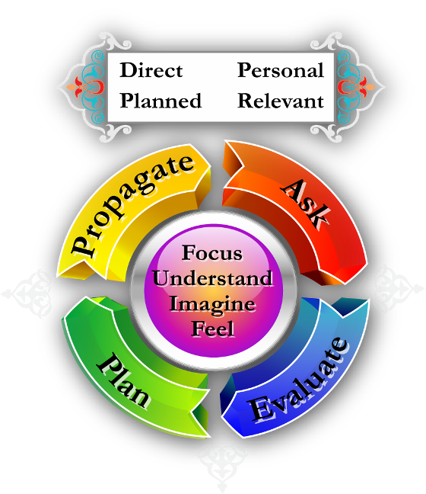
تدبُّر &تذكُّرA simple method for:
In the next slide
www.understandquran.com
Notes:
After making du’aa, one should check what he did yesterday / last week.
And then make plans (if you fail to plan, you plan to fail) for tomorrow.
These should be individual as well as collective.
And then convey it to others.

Slide 45
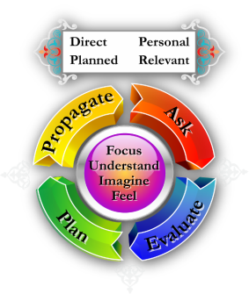
تدبُّر &تذكُّر: A simple method for
ASK: Each verse of the Qur’an demands something from us. To fulfill it, start with supplication.
EVALUATE your past day or week in the light of that supplication. Ex: Student
Make a PLAN of the next day / week.
PROPAGATE the message (The Prophet pbuh said: “Convey from me, even if it is one verse”).
www.understandquran.com
Notes:
You know tadabbur. Now comes tazakkur. This is to relate it with day-to-day life.
How can we do that? Here is a simple approach. (There can be other ways too).
Try to extract a du’aa from the verse! Why? (i) Each verse has a message on which we have to act. And that act can be started with du’aa.
(ii) Sahabah always looked their interest every piece of information. What can I get in it. Example: The Prophet once said: “there are seventy thousand who shall enter Jannah without being taken to account or torment." He also said: They are those who do not make Ruqyah nor seek it, nor perceive omens but keep trust in their Rubb (Allah).'' On this 'Ukashah bin Mihsan stood up and asked: "Pray to Allah to make me one of them.'' The Prophet (PBUH) said, "You are one of them.'' Then another man stood up and asked the same thing. The Prophet (PBUH) answered, "'Ukashah has surpassed you".

Slide 46
Check!
When it comes to group or Fiqh issues or any new idea, then please check with scholars before you mention it to others or implement it.
Then what is the real area for common people like us?
Relationship with Allah, Following the Prophet pbuh, planning for the Hereafter, Zikr, Worship, Morals, Dealings, Dawah, Preaching and Propagation, Ordering good and Stopping evil, Team Spirit, etc.
Check
www.understandquran.com
Notes:
You can surely think about solution to bigger issues but make sure to check with scholars before telling them to anyone or before acting upon them.

Slide 47
Evaluate and Plan
Just Prayer / supplication is not enough. One should evaluate his performance and make plans.
Example: Do you think a student who just asks Allah to help him succeed is sincere if he does not follow it up with studies?
www.understandquran.com
Notes:
An’amta alaihim: Ambiyaa, siddiqeen,shuhadaa, saliheen;
Top: our Prophet pbuh; His path? Practice, Preach, and Organize, and implement (what he can). So, our du’aa should be to ask Allah to help us do them.
And then start doing them. If we don’t do this, then our duaa is NOT SERIOUS! (Example: Job seeker who just makes du’aa but does not go out to seek job.)

Slide 48
May Allah help us fulfill the Rights of the Qur’an
Believe in it
Read it
Understand it
Ponder its verses
Act upon it
Spread it
Aameen!
www.understandquran.com

Slide 49
Did you find?
“Understand and ponder this book”

Slide 50
Now listen to the verse!

Slide 51
Practice with Imagination and Feelings
كِتَابٌ | أَنزَلْنَاهُ
We have
revealed it
(It is) a book
إِلَيْكَ | مُبَارَكٌ
full of
blessings;
to you (O! Muhammad, pbuh)

Slide 52
Practice
لِّيَدَّبَّرُوا | آيَاتِهِ
so that they ponder | its verses
وَلِيَتَذَكَّرَ | أُوْلُوا | الْأَلْبَابِ (ص 29)
and so that (they) receive admonition | those of | understanding.

Slide 53
TPS-W
Think
1 minute
Pair & Share
2 minutes
Write
4 minutes

