Slide 1
Let’s Understand the Qur’an

Lesson -10a
Dr. Abdulazeez Abdulraheem

Slide 2
In this lesson…
Qur’an: Surah Ikhlaas
Grammar : إَفْعَلْ، إَفْعَلُوا، لاَ تَفْعَلْ، لاَ تَفْعَلُوا
Educational tip: Repetition
In this lesson you will learn 2 new words which occur in Qur’an almost 432 times
Notes:
2
Allah has chosen you out of the thousands that are out there. Thank Allah for this tremendous blessing by learning with full attention and interaction.
You have already come walking towards Allah. Now He will come running towards you (as in Hadith). InshaAllah, you will continue in this journey till the end.

Slide 3
By the end of this lesson, we will learn
78,000
58 words, which occur in quran almost 26,689 times
There are 4,500 words in Qur’an which are repeated almost 78,000 times
26,689

Slide 4
Introduction سُورَة الاخْلاَص
Revealed in the early Period of Mecca
The name of the Surah “Al-Ikhlaas”- means “The Purity”, thereby whoever recites it with understanding and belief, his ‘Imaan’ becomes pure.
This is an answer to the people who ask, “To which Lord do you worship?”

Slide 5
Points
Sunnah of Prophet SAS to recite once after every obligatory prayer and three times after Fajr and Maghrib Prayers.
Sunnah of Prophet to recite in the the Sunnah prayers of Fajr and Maghrib
This is a perfect description as to which entity could be worthy worshipping
Equals to 1/3rd of Qur’an

Slide 6
سُورَةُ الإخلاص
قُلْ | هُوَ | اﷲ ُ | أَحَدٌ (1)
Say, | “He | (is) Allah, | [who is] One.

Slide 7
قُلْ | هُوَ | اﷲ ُ | أَحَدٌ (1)
Say, | “He | (is) Allah, | [who is] One.
ق و ل
Almost
350 times
Say!

Slide 8
قُلْ | هُوَ | اﷲ ُ | أَحَدٌ (1)
Say, | “He | (is) Allah, | [who is] One.
Second translation
هُوَ اﷲ ُ
He is Allah.

Slide 9
قُلْ | هُوَ | اﷲ ُ | أَحَدٌ (1)
Say, | “He | (is) Allah, | [who is] One.
أ ح د
Used only
for Allah
One and only

Slide 10
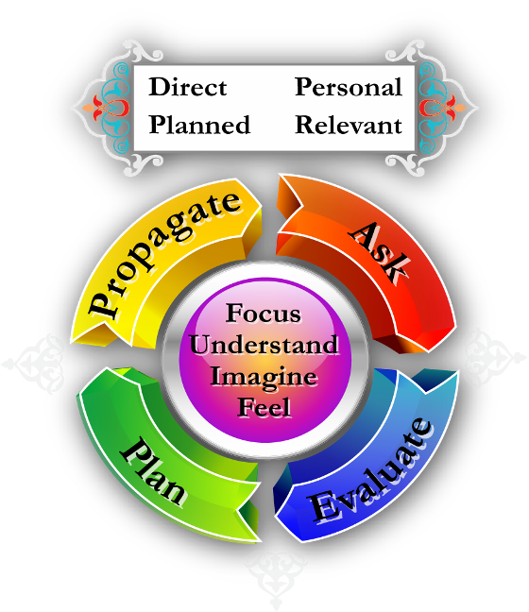
Message

Slide 11
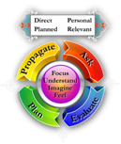
Message from:
قُلْ | هُوَ | اﷲ ُ | أَحَدٌ (1)
Say, | “He | (is) Allah, | [who is] One.
Ask: O Allah! Help me to make You alone as the true God and to obey You alone.
Evaluate: How many times have I obeyed my ‘Nafs’:(أفرأيت من اتّخذ إلهه هواه)
How many times obeyed Shaitan? (ألاّ تعبدوا الشيطان)
Why? Because of friends, TV, Internet…..
Plan: To Worship and Obey Just Allah,
قُل= Propagate

Slide 12
Practice with imagination; feelings prayer
قُلْ | هُوَ
Say,
“He
اﷲ ُ | أَحَدٌ (1)
[who is] One.
(is) Allah,

Slide 13
سُورَةُ الإخلاص
اَﷲ ُ | الصَّمَدُ (2)
Allah, | the Self-Sufficient.

Slide 14
اَﷲ ُ | الصَّمَدُ (2)
Allah, | the Self-Sufficient.
the Self-Sufficient

Slide 15
اللَّهُ الصَّمَدُ {2}
He needs no one
Everyone needs him
Notes:
15
Protect us from making our nafs (and money, worldly things, fame, etc.) a god. AEPP (check)
Yalid/Yoolad: Walid, Walida, Walidayn, Aulaad, milaad, maulood, wiladah
Lam: Did nots
Iklaas in faith and/or in niyyah?
Allahussamad: O Allah make us your beggar only! Be impressed with none.
No kufu: O Allah! Just make us fear You alone!
Ahad: Two meanings

Slide 16
Message from:
اَﷲ ُ | الصَّمَدُ (2)
Allah, | the Self-Sufficient.
My heart should be filled with His Greatness and His High Position.
O Allah! Please be enough for me (Ex: Someone says he has 1,000’s of jobs … and you are jobless)

Slide 17
Practice with imagination; feelings & prayer
اَﷲ ُ | الصَّمَدُ (2)
the Self-Sufficient.
Allah,

Slide 18
سُورَةُ الإخلاص
لَمْ يَلِدْ | وَلَمْ | يُولَدْ (3)
He did neither beget | and nor | is He begotten,

Slide 19
لَمْ يَلِدْ | وَلَمْ | يُولَدْ (3)
He did neither beget | and nor | is He begotten,
لَنْ
لَمْ
و ل د
did not
will not

Slide 20
لَمْ يَلِدْ | وَلَمْ | يُولَدْ (3)
He did neither beget | and nor | is He begotten,
و ل د
يَلِدْ
لَمْ
beget
He did not

Slide 21
لَمْ يَلِدْ | وَلَمْ | يُولَدْ (3)
He did neither beget | and nor | is He begotten,
لَمْ
لَنْ
و ل د
did not
will not

Slide 22
لَمْ يَلِدْ | وَلَمْ | يُولَدْ (3)
He did neither beget | and nor | is He begotten,
و ل د
يَلِد
begets
(active voice)
يُولَد
is begotten
(passive voice)

Slide 23
لَمْ يَلِدْ | وَلَمْ | يُولَدْ (3)
He did neither beget | and nor | is He begotten,
و ل د
والد، والدۃ، والدين،
اولاد، ولادة، ميلاد

Slide 24
Message from:
لَمْ يَلِدْ | وَلَمْ | يُولَدْ (3)
He did neither beget | and nor | is He begotten,
Imagine the past: 100 yrs, 1000 yrs, million yrs, billion yrs, trillions yrs, zillions yrs, …. and He was there!
Imagine the future also… and fill your heart with awe and respect and love
To say that Allah has a son (Isa A.S.), is absolutely wrong

Slide 25
Practice with imagination; feelings & prayer
لَمْ يَلِدْ | وَلَمْ
He did neither beget
and nor
يُولَدْ (3)
is He begotten,

Slide 26
سُورَةُ الإخلاص
وَ لَمْ يَكُن | لَّه، | كُفُوًا | أَحَدٌ (4)
And (there) is not | unto Him | comparable | Anyone.

Slide 27
وَ لَمْ يَكُن | لَّه، | كُفُوًا | أَحَدٌ (4)
And (there) is not | unto Him | comparable | Anyone.
ك و ن
يَكُن
وَ
لَمْ
is
not
and

Slide 28
وَ لَمْ يَكُن | لَّه، | كُفُوًا | أَحَدٌ (4)
And (there) is not | unto Him | comparable | Anyone.
لَه،
لَهُمْ
لَكَ
لَكُمْ
لِي
لَنَا
لَهَا
for Him,
unto Him
لَكُمْ دِينُكُمْ وَلِيَ دِين

Slide 29
وَ لَمْ يَكُن | لَّه، | كُفُوًا | أَحَدٌ (4)
And (there) is not | unto Him | comparable | Anyone.
ك ف ء
Equal,
Similar qualities

Slide 30
In matrimonials…
Scholar’s Recommendation
Girls’ family
Boy’s family

Slide 31
وَ لَمْ يَكُن | لَّه، | كُفُوًا | أَحَدٌ (4)
And (there) is not | unto Him | comparable | anyone.
أ ح د
anyone

Slide 32
قُلْ هُوَ اللَّهُ أَحَدٌ {1} ....
وَلَمْ يَكُن لَّه، كُفُوًا أَحَدٌ {4}
One (for Allah only)
Anyone
Notes:
Do we do that when we complete any Islamic work???? AEPP (Ask-Evaluate, Plan, Propagate).

Slide 33
Message from:
وَ لَمْ يَكُن | لَّه، | كُفُوًا | أَحَدٌ (4)
And (there) is not | unto Him | comparable | Anyone.
One should have such a feeling that nobody is equal or comparable to Him in any way regarding:
Entity
Attributes
Rights
Powers of Allah

Slide 34
Message from:
وَ لَمْ يَكُن | لَّه، | كُفُوًا | أَحَدٌ (4)
And (there) is not | unto Him | comparable | Anyone.
Evaluate:
Is there anybody whom I am afraid of?
Do I expect some benefits from someone else?
Do I think that someone is more powerful than Allah
O Allah! you be enough for me.

Slide 35
Message from:
وَ لَمْ يَكُن | لَّه، | كُفُوًا | أَحَدٌ (4)
And (there) is not | unto Him | comparable | Anyone.
Esp. with Imagination & feelings; Prayer & Evaluation

Slide 36
Lessons from Surah
Neither there is a partner of Allah nor he has any relations.
There is no partner of Allah in his Qualities (Like no one knows the unknown)
There is no partner of Allah in his Rights (Worshipping Allah alone)
There is no partner of Allah in his Powers, (All the laws should be from Allah)
We should not only propagate this but also correct the wrongs.
We are required to plan for these.

Slide 37
Story of a companion of Prophet SAS
he used to recite Surah Ikhlaas in every rakah of Salah
When he was asked why he does so, he said because I love this Surah.
Prophet SAS said, “Your love for it will admit you to Jannah.”

Slide 38
Recite it with Love
Example: Your relative!...
Allah is my creator, provider, whom I love, and He is my Mohsin!! Why not I remember him continuously?
And there is no one like my Rabb, and there will not be.
Feel the greatness and love of Allah, when you recite this Surah
Plan to propagate the oneness of Allah

Slide 39
New words in this lesson
قُلْ هُوَ اﷲ ُ أَحَدٌ ، وَ لَمْ يَكُن لَّه، كُفُوًا أَحَدٌ | أحَد | 85
لَمْ يَلِدْ وَلَمْ يُولَدْ | لَمْ | 347
Notes:
Short cut Du’aa (with inshaAllah)… Excellent point.

Slide 40
Revision…

Slide 41
سُورَة الإِخْلاَص

قُلْ | هُوَ | اﷲ ُ | أَحَدٌ (1)
Say, | “He | (is) Allah, | [who is] One.
اَﷲ ُ | الصَّمَدُ (2)
Allah | The Self-Sufficient

Slide 42
سُورَة الإِخْلاَص
لَمْ يَلِدْ | وَلَمْ يُولَدْ (3)
He did neither beget | and nor is He begotten
وَ لَمْ يَكُن | لَّه، | كُفُوًا | أَحَدٌ (4)
And (there) is not | unto Him | comparable | anyone.

Slide 43
Break!

